Slide 1
HEALTH AND SAFETY POLICIES
OUTLINES
1. OCCUPATIONAL SAFETY AND HEALTH ADMINISTRATION
2. HAZARDS COMMUNICATION STANDARDS
3. GUIDELINES FOR ESTABLISHING SCIENTIFIC LACORATORIES OR UNIVERSITY LABORATORY POLICIES
4. LABORATORY ORGANIZATION CHARTS AND RELATIONS

Slide 2

Health And Safety Policies Was Brought Into Full Act In The Year 1974

Slide 3
ABOUT HEALTH AND SAFETY POLICY
This Health and Safety Policy is produced in accordance with the requirements of Section 2 (3) of the Health and Safety at Work etc. Act 1974.
The Health and Safety policy consist of four parts:
Part 1 – The Statement of Intent and policy objectives;
Part 2 –How responsibilities are assigned for achieving the objectives set out in part one;
Part 3 –Related policies and procedures for implementing the Health and Safety Policy;
Part 4 – The arrangements for measuring, monitoring and reviewing the School’s performance in relation to Health and Safety.

Slide 4
1. STATEMENT OF INTENT AND POLICY OBJECTIVES
EXAMPLE INCLUDE;
To provide, as far as reasonably practicable, a safe and healthy working environment, safe premises and facilities for staff, students and visitors;
To create for employees, as far as is practicable, a working environment where potential work- related stressors are avoided, minimised or mitigated through good management practices, effective human resources policies and staff development;
To ensure that all staff are aware of their health and safety responsibilities and know what is expected of them and what they must do to discharge the responsibilities assigned to them;

Slide 5
To ensure that staff have access to appropriate training and development to enable them to discharge competently the responsibilities assigned to them;
To have an effective system for communicating and consulting on health and safety matters, and securing the co-operation of employees and students in implementing the Health and Safety Policy;
To have in place arrangements to plan, implement, monitor and review measures to address risks arising from the School’s activities;
To strive to improve continuously the School’s health and safety performance, measuring its progress against agreed performance standards and Higher Education sector benchmarking.

Slide 6
2. RESPONSIBILITIES AND ACCOUNTABILITIES FOR HEALTH AND SAFETY
EXAMPLE INCLUDE;
The Director will:
endorse and sign the School’s Health and Safety Policy and any revisions agreed by the Executive Health and Safety Group;
through the delegation to the School Secretary seek the advice of the School’s senior managers through the Executive Health and Safety Group as appropriate to ensure that health and safety issues are considered and incorporated into the general planning, provision of resources and co-ordination of the School’s operations.
The School Secretary will discharge her responsibilities by:
chairing the Executive Health and Safety Group;
ensuring that the Director and Council are kept informed on significant health and safety developments and risks by providing relevant reports as required; and liaising with senior colleagues to promote greater integration of health and safety considerations into the planning and operation of School activities.

Slide 7
The Students;
The School expects all students to co-operate with its efforts to protect their health, safety, and welfare.
Students must take reasonable care of their own safety and not place others at risk by their actions.
Students must not engage in reckless or careless behaviour that might compromise the School’s preventive and protective measures (such as letting off fire extinguishers without good cause, or maliciously setting off the fire alarm).
Students must not intentionally damage or misuse any equipment, such as wedging open kitchen fire doors in Halls of Residence and must report defects or unsafe situations to the Estates Division and/or the School’s Health and Safety Team.
Students must adhere to the School’s fire and emergency procedures, by evacuating the building if the fire alarm sounds and going to the emergency assembly point. They must follow any instructions given to them by fire wardens, Security Staff or, in the case halls of residence, residential staff.
If a Student has an accident whilst on School premises, they should report it to the School Health and Safety Team via the main reception in Old Building if the incident occurs on the Houghton Street site or to the duty manager if the accident occurs in one of the Halls of Residence (further details on the arrangements for reporting accidents are provided on the Health and Safety website).

Slide 8
3. ARRANGEMENTS FOR IMPLEMENTING THE POLICY
Arrangements for implementing the School’s Health and Safety Policy are posted on the LSE’s Health and Safety website: www.lse.ac.uk/intranet/LSEServices/healthAndSafety/Home.aspx
These include procedures for fire prevention and actions to be taken in the event of fire, accident reporting, working with computers and other common health and safety topics.
These arrangements will be supplemented by additional procedures and guidance as and when necessary. These will be kept under review and updated as required.
Arrangements for addressing risks that are specific to a particular department will be detailed in the local safety policy statement.

Slide 9
4. ARRANGEMENTS FOR MEASURING PERFORMANCE AND MONITORING AND REVIEW THE HEALTH AND SAFETY POLICY
Performance Standards
The Executive Health and Safety Group will agree appropriate performance standards against which the School will measure the effectiveness of its health and safety management system.
Current performance standards cover:
safety policies and local policy statements
health and safety information and training given to staff, students, visitors and contractors
risk assessments
stress management and well-being
annual reporting to Council

Slide 10
Monitoring and Reviewing the Health and Safety Policy and related procedures.
The Health and Safety Policy will be reviewed annually by the Head of Health and Safety in conjunction with the Executive Health and Safety Group. It will be amended as appropriate and will be supplemented by further statements, policies or procedures as necessary.
The Head of Health and Safety will make arrangements for an annual audit of a sample of academic and administrative departments to assess compliance with the School’s health and safety policies and procedures, and the findings of the audit will be reported to the Head of Department or Head of Unit and the Executive Health and Safety Group, with any recommendations for improvements.
The School Secretary will report annually to Council on the progress made to implement the Health and Safety Policy and achieve compliance with health and safety legislation.

Slide 11

That’s about Health and Safety Polices we are now moving to one of the guidelines of the policies which is OSHA

Slide 12


Slide 13


Slide 14


Slide 15


Slide 16


Slide 17


Slide 18


Slide 19


Slide 20


Slide 21


Slide 22


Slide 23


Slide 24
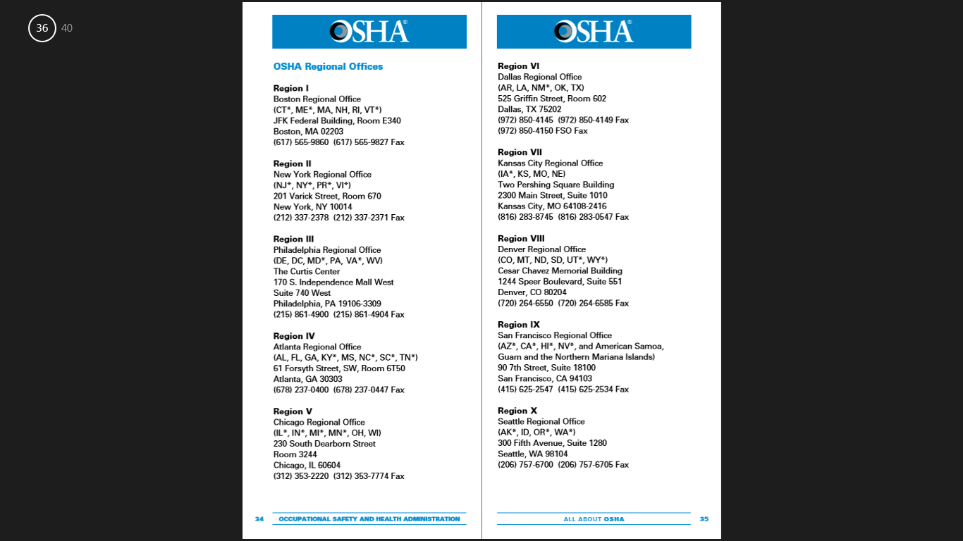

Slide 25


Slide 26
We just concluded the facts about OSHA to get to know more use their official website; www.osha.gov
We now go to Hazards Communication Standards

Slide 27
HAZARD COMMUNICATION STANDARDS
In order to ensure chemical safety in the workplace, information about the identities and hazards of the chemicals must be made available and understandable to workers/students.
Chemical manufacturers and importers are required to evaluate the hazards of the chemicals they produce or import, and prepare labels and safety data sheets to convey the hazard information to the students/workers.
All employers with hazardous chemicals in their workplaces must have labels and safety data sheets for their exposed workers and train them properly on its uses.

Slide 28
MAJOR CHANGES TO THE HAZARD COMMUNICATION STANDARD
Hazard Classification; Provides specific criteria for classification of health and physical hazards, as well as classification of mixtures.
Labels; Chemical manufacturers will be required to provide a label that includes a harmonized signal word and hazard statement for each hazard class and category.
Safety Data Sheets; Will now have a specified format.
Information and training; Employers are required to train workers on the new labels elements and safety data sheets format to facilitate recognition and understanding.

Slide 29
UNIVERSITY LABORATORY POLICIES
There is the Research Laboratory Policy which includes;
1. Eating and Drinking are not allowed
2. students have to submit the material safety data sheets (MSDS) of all the chemicals they need for their thesis. They have to give a signed copy (sign their respective names, ID numbers, thesis advisers, and title of the thesis on the sheets) of the MSDS before they can get their chemicals, as this ensures that the students have read the MSDS and that they know what to do in case of an accident.
3. Faculty, technicians, and students must wear the appropriate attire in the laboratory. Laboratory gown (white, knee-length or longer with sleeves at least elbow length) and safety goggles must be worn properly during the performance of the experiments. Dark glasses/shades in place of safety goggles are not permitted. Students without lab gowns and/or safety goggles are not allowed to perform their thesis experiments in the laboratory No open-toed footwear is allowed. Long hair must be tied back.
4. Proper disposal of waste chemicals must be observed. Waste containers must be appropriate for the waste chemical. Waste containers must be properly labelled;
A) Chemical Name (Specific name must be listed. No abbreviations or trade mark names are to be used.
B) Date of Disposal, Student/researcher name and Student/researcher contact number

Slide 30
6. Bags, books, and other paraphernalia unnecessary to the experiment to be performed are to be placed away from the experiment area.
7. Requests for chemicals, glassware, or any other laboratory materials must be made by filling out the borrower’s form which may be downloaded at http://www.dlsu.edu.ph/academics/colleges/cos/physics/_pdf/borrowers-form.pdf. In this way, the academic service faculty and the technician can track down a student who is currently responsible for a particular material/equipment in the lab.
8. Safety rules and regulations regarding the use of instruments must be strictly followed by all students in the laboratory.

Slide 31
TEACHING LABORATORY POLICIES
1. General Policies
a. Refrain from smoking, eating, drinking, and littering in all physics laboratories.
b. Stay inside the laboratory only during lab classes. Only officially enrolled students are per mitted inside the lab.
c. Use all laboratory fixtures properly. Do not sit on tables and do not open cabinets or lockers unless there is an instruction to do so.
d. Turn off all electrical appliances in the laboratory if they are not being used. If you are the last person to leave the laboratory, turn off the lights, fans, air conditioners, projectors, and computers, lock the doors, and close the windows.
e. Use only the computers in the physics lab for purposes related to experiments performed.
f. Maintain the cleanliness of the lab at all times. Always observe proper safety procedures in the lab.
g. Students are not allowed to stay inside the classroom beyond their class hours.

Slide 32
BORROWING PROCEDURES AND USE OF EQUIPMEMENT
a) All pieces of equipment necessary for physics experiments may be borrowed from the Physics Stockroom.
b. Students must present an accomplished equipment borrowing form and an ID before any lab equipment is loaned. Equipment- borrowing forms are available at the Physics Stockroom.
c. Borrow only the pieces of equipment which are specified in your experiment or are required by the lab instructor.
d. The borrower and his/her group are held responsible for all pieces of equipment borrowed from the Physics Stockroom.
Note that the laboratory must have a substantially amount of borrowing forms available for the students
e. Pieces of equipment borrowed must be returned upon completion of the experiment.

Slide 33
LAB SAFETY
Students are advised to read all precautionary notes on all pieces of equipment before using them. All questions about safety precautions on the equipment being used must be addressed to the lab instructor.
The lab instructor must first check the set-up for experiments requiring the use of electrical components before any of these are plugged in or turned on. In case of faulty equipment, the instructor must be informed immediately so that a replacement can be secured from the Physics Stockroom.
Experiments involving the use of boiling water, heaters, and the like must be performed close to the water sinks in the lab. Proper safety procedures must be employed when performing such experiments.
Chemicals used in some experiments must be handled with utmost care. Used and unused chemicals must be returned to the Physics Stockroom as soon as the experiment is finished. Chemicals should never be thrown into the water sinks or the trash bins.
All injuries, however minor, must be reported to the lab instructor.

Slide 34
SPECIAL LAB EXPERIMENT
Special or make-up experiments outside of regular class hours are discouraged.
In case of a special or make-up experiment outside the regular class hours, the student has to confirm the availability of the technicians, the equipment, and the lab room before scheduling one with his/her instructor. Special or make-up experiments must only be performed in a lab room.
Special or make-up experiments outside the regular class hours are allowed only upon the approval of the lab instructor. No special or make-up experiments are allowed if the lab instructor cannot be present during the special or make-up experiment.
Lab technicians are not required to assist the student during the special or make- up experiment.

Slide 35
ROLE OF LABORATORY TECHNICIANS
The lab technicians are responsible for the safekeeping and lending of all pieces of equipment used in the Physics Teaching Lab.
The lab technicians may be requested by the lab instructor to assist during a lab experiment but they are not required to stay in the lab rooms.
Lab technicians are tasked to check the conditions of all pieces of equipment that are returned to them. In case of broken, lost, or damaged equipment, the technicians are authorized to note down all information about the borrower which will be necessary for proper documentation.

Slide 36
BREAKAGE, LOSS AND DAMAGE TO THE LAB EQUIPMENT
Any incident of breakage, loss, or damage to any lab equipment must be reported immediately to the lab instructor.
The borrower and his/her group members are responsible for the replacement or payment of the broken, lost, or damaged equipment.
The cost of the damage to the equipment is assessed by the lab coordinator and technicians and a billing statement is forwarded to the borrower.
Students must pay for, repair, or replace the broken, lost, or damaged equipment on or before the 12th week of the trimester; otherwise, they would not be cleared from the lab and not be allowed to enroll in the following trimester. Furthermore, they would not be given their final grade for that lab subject.
Once the equipment has been paid for, replaced or repaired, students would be issued a clearance by the lab coordinator.

Slide 37
USE OF EQUIPMENT FOR OVERNIGHT EXPERIMENT
Only faculty members of the Physics Department are allowed to use the lab equipment for overnight experiments.
The lab coordinator and lab technicians must be informed in writing, using the appropriate forms, prior to the use of any equipment.
The equipment borrowed may only be used in either the Physics Teaching Lab or the STRC Physics Research Lab unless a permission to use the equipment outside the campus has been secured from the lab coordinator.

Slide 38
LABORATORY ORGANIZATION CHARTS AND RELATIONS
WHY???
It is important to have a clear overview of the position of the laboratory in the organization and the organizational structure within the laboratory itself. Staffs need to understand the relationship between quality management, technical operations, support and satellite services and the hierarchical structure within the organization.
WHAT IS ORGANIZATIONAL CHART
These are tools that are used to create a transparent and logical organization. It can also be considered as the map o the organization, it shows which place the laboratory has in the organization and it shows which positions exists in the laboratory and which positions don't have authority over other positions

Slide 39
HOW IS IT CREATED
1. If the laboratory is part of a hospital or other organization, two organizational charts are needed;
a) One Organizational chart showing the location of the laboratory in the organization.
b) One chart showing the positions within the laboratory itself.
2. Make a list of names of all the positions in the laboratory. Example include; Laboratory Manager, Laboratory Attendant and the likes.
3. Using this list, make the Organizational Chart. In the chart, every section must be clearly distinguishable, including its relations to other positions in the hierarchy. Each position job and what its accountable for should not be mixed with other positions in the organizational chart.
4. Make a short description of each positions (300 words), that is, its core functions and responsibilities.
5. List for each positions the names of the staff members in that position also indicating who can replace him/her in that position when unavailable.
6. When the Organizational Chart has been made, it must be reviewed, signed and dated by the management of the total Organization.

Slide 40
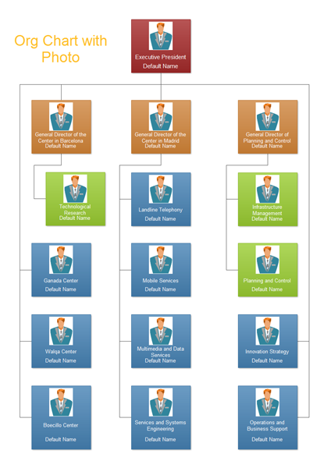

Slide 42
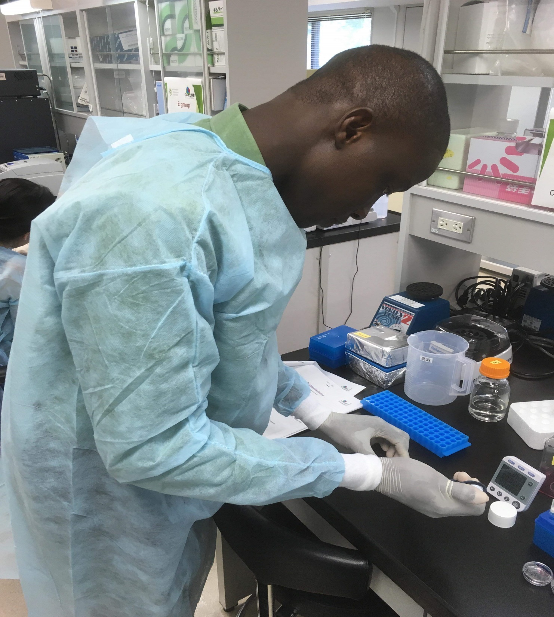
ARIGATOU!

